Slide 1
Data Visualization of Bird Strikes between 2000 – 2011

Slide 2
Project analysis slide 3
Project Analysis
TOTAL BIRD STRIKES
BIRDS STRUCK
AVERAGE ALTITUTE
AIRCRAFT DAMAGE
ECONOMIC IMPACT
24,750 OVER
12 YEARS
67,000, INDICATING MULTIPLE BIRDS PER INCIDENT.
801.54 FEET, MOSTLY DURING TAKE-OFF,LANDING,OR APPROACH
9.63% OF STRIKES RESULTED IN DAMAGE.
TOTAL COSTS AMOUNTED TO $136 MILLION.

Slide 3
Project analysis slide 3
Project Analysis
MAXIMUM STRIKES IN A YEAR
PHASE OF FLIGHT
FLIGHT ALTITUDES
MOST PRONE STATE
INJURIES
2009 RECORDED THE MOST STRIKES WITH 3,152 INCIDENTS.
APPROACH PHASE WAS MOST SUSCEPTIBLE
80% OF BIRD STRIKES OCCURRED BELOW 1,000 FEET.
CALIFORNIA REPORTED THE HIGHEST NUMBER OF INCIDENTS.
21 REPORTED INJURIES, HIGHLIGHTING SAFETY CONCERNS.

Slide 4
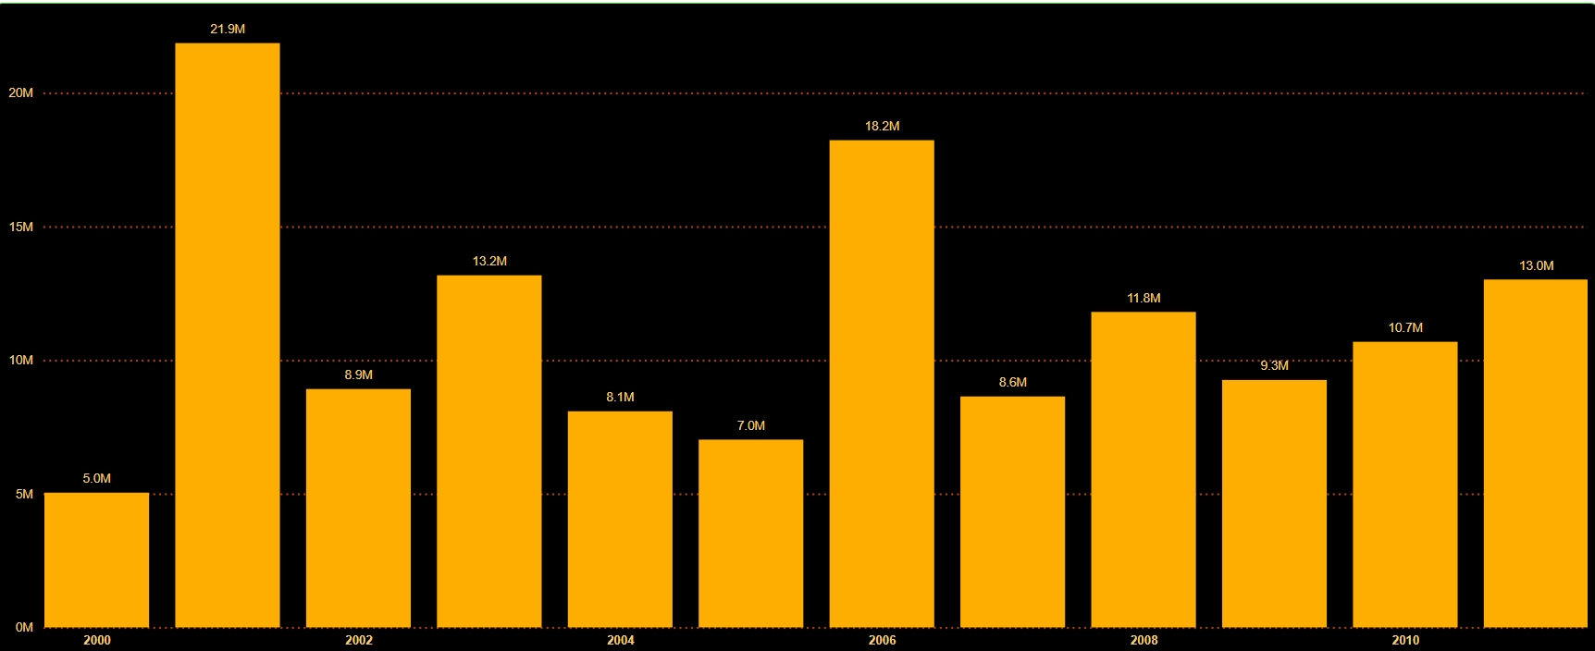
Project analysis slide 5
Economic Impact Analysis
PEAK YEAR FOR BIRD STRIKES COSTS
HIGH ANNUAL COSTS IN MULTIPLE YEARS
COST REDUCTIONS YEARS
2001
2001,2003,2006
2004,2007
The highest economic impact was recorded in 2002,with costs reaching $21.9 million.
Several years, including 2001,2003,2006,2008,2010 and 2011, saw annual bird strikes costs exceed $10 million.
There were notable reductions in bird strike expenses in 2002 and 2007, with costs falling to $8.9 million and $8.6 million, respectively.

Slide 5
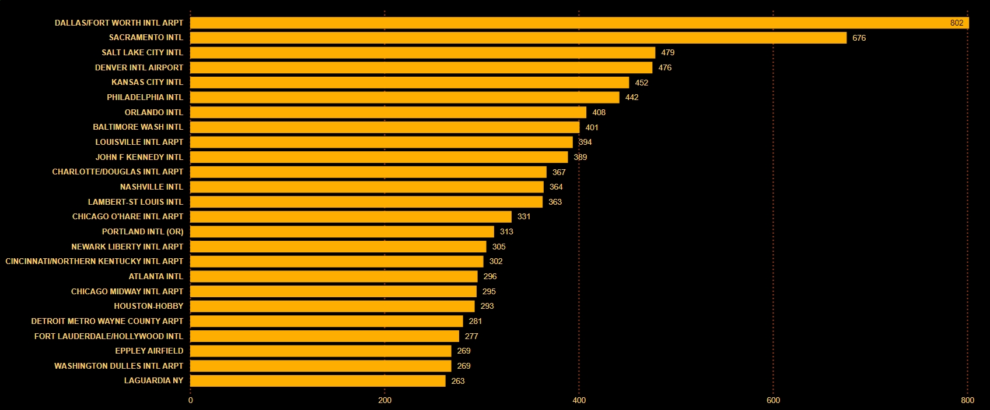
Project analysis slide 10
Top 50 Airport Encounter Max Strikes

Slide 6
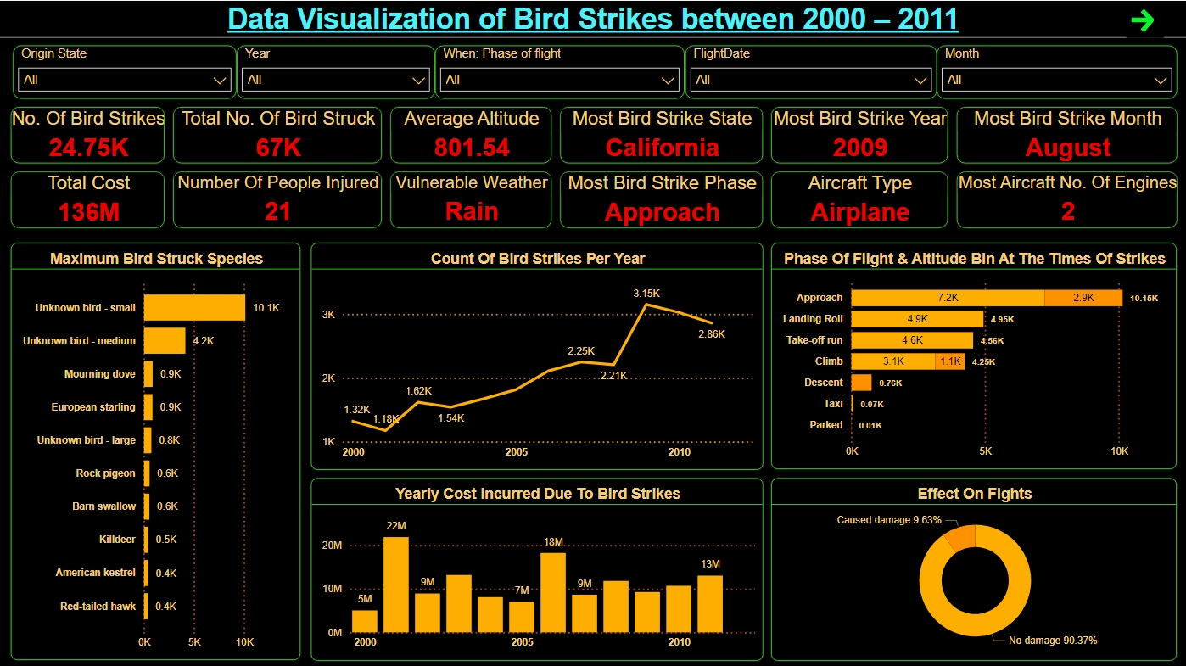
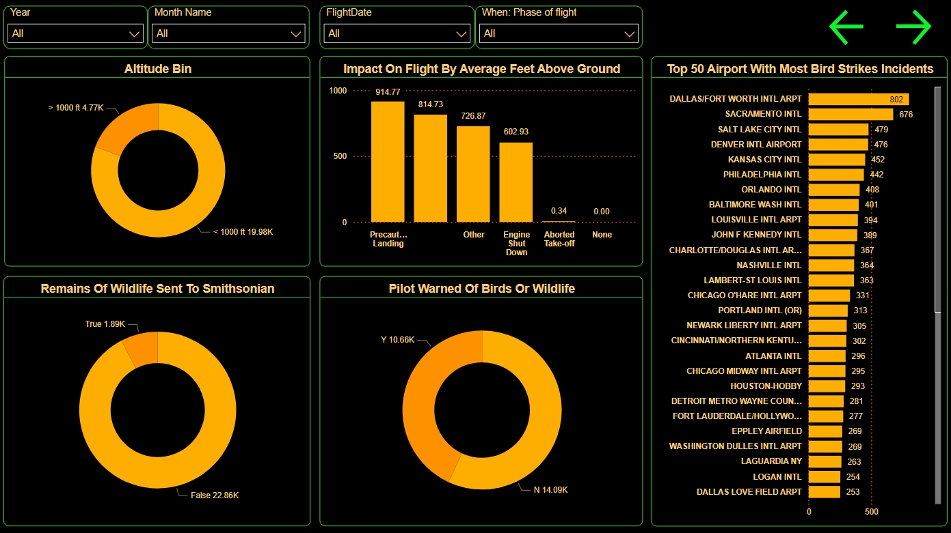
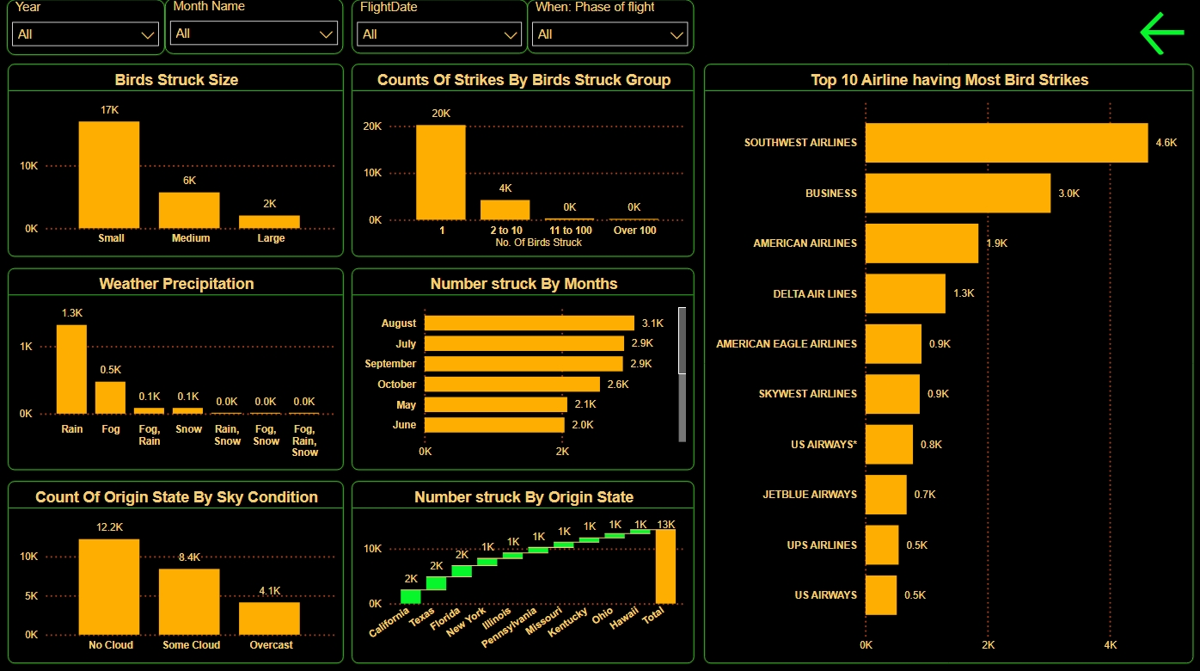
Project analysis slide 10
Report Look

Slide 7
Thank You

